Slide 1
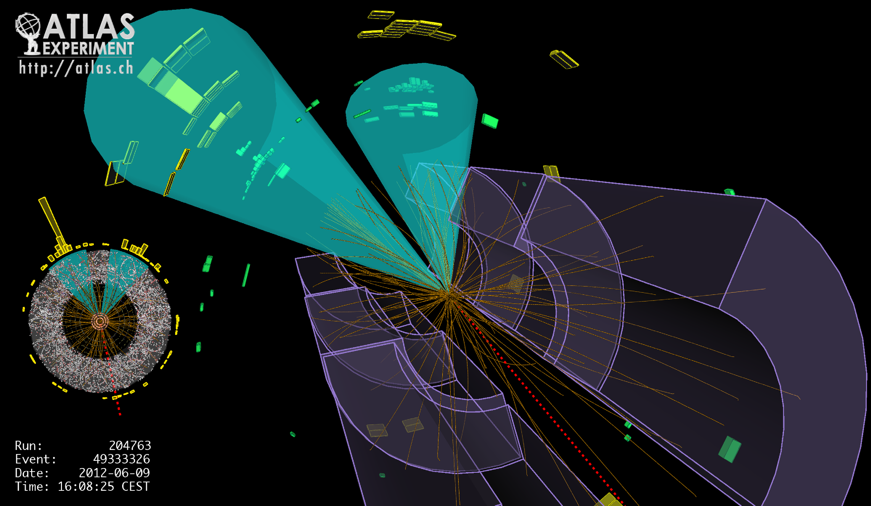
Lecture #12
Prof. Dr. Florencia Canelli
Universität Zürich
Elementary particle physics - PHY451
HS2016

Slide 2
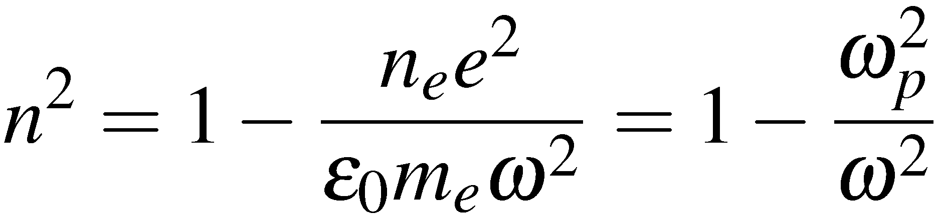
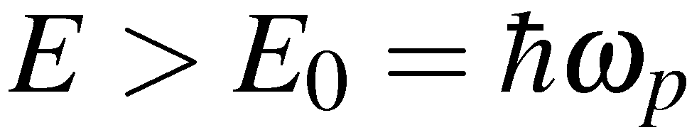
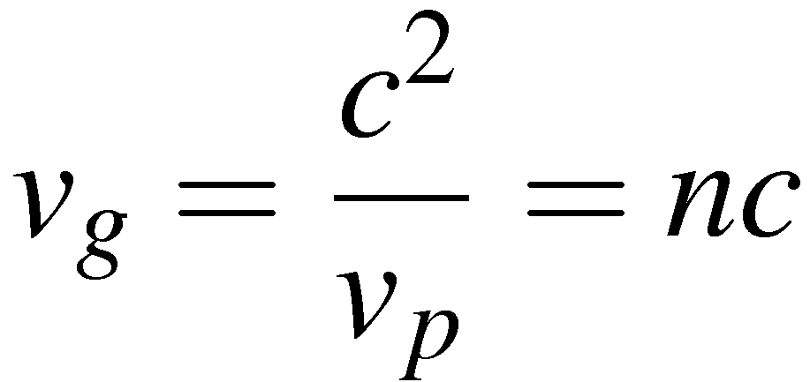
The Higgs mechanism
As it stands there is a small problem; this only works for massless gauge bosons. Introducing masses in any naïve way violates the underlying gauge symmetry.
The Higgs mechanism provides a way of giving the gauge bosons mass
Here we motivate the main idea behind the Higgs mechanism (however
not possible to give a rigourous treatment outside of QFT). So resort to analogy:
Analogy:
Consider Electromagnetic Radiation propagating through a plasma
Because the plasma acts as a polarisable medium obtain “dispersion relation”
n = refractive index
ω = angular frequency
ω_{p} = plasma frequency
From IB EM:
Because of interactions with the plasma, wave-groups only propagate if they
have frequency/energy greater than some minimum value
Above this energy waves propagate with a group velocity

Slide 3
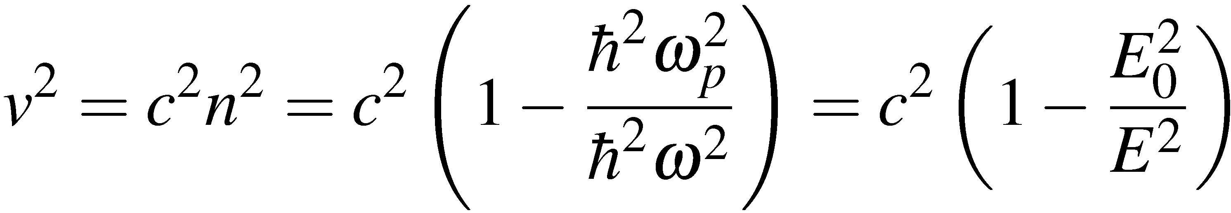
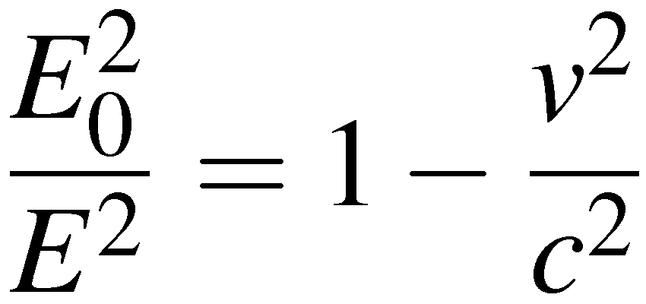
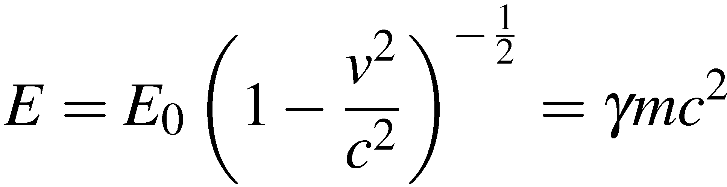
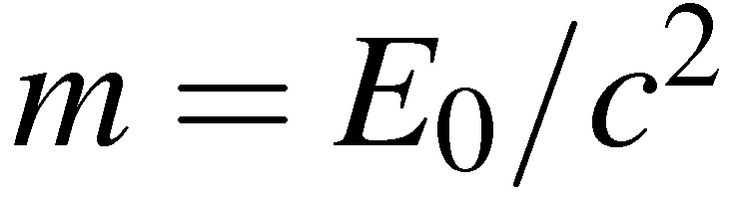
The Higgs Mechanism
Dropping the subscript and using the previous expression for n
Rearranging gives
with
Massless photons propagating through a plasma behave as massive particles
propagating in a vacuum !
Propose a scalar (spin 0 ) field with a non-zero vacuum expectation value (VEV)
Massless Gauge Bosons propagating through the vacuum with
a non-zero Higgs VEV correspond to massive particles.
The Higgs is electrically neutral but carries weak hypercharge of 1/2
The photon does not couple to the Higgs field and remains massless
The W bosons and the Z couple to weak hypercharge and become massive

Slide 4
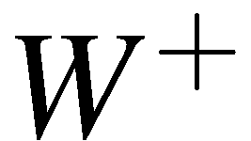

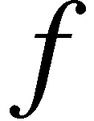
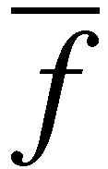
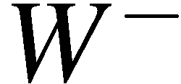
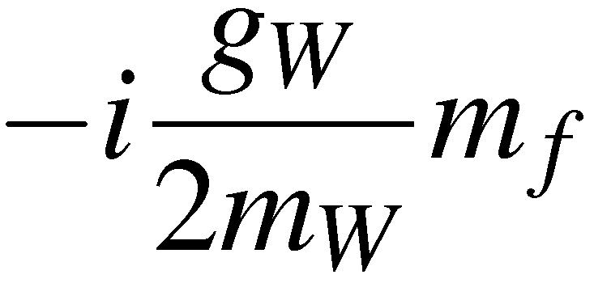
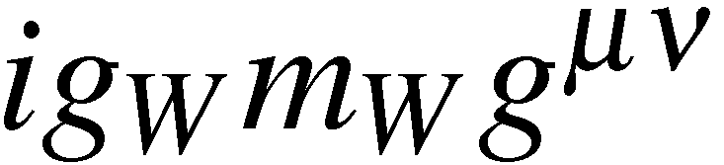
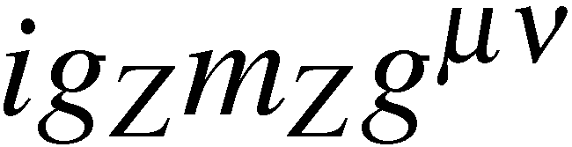
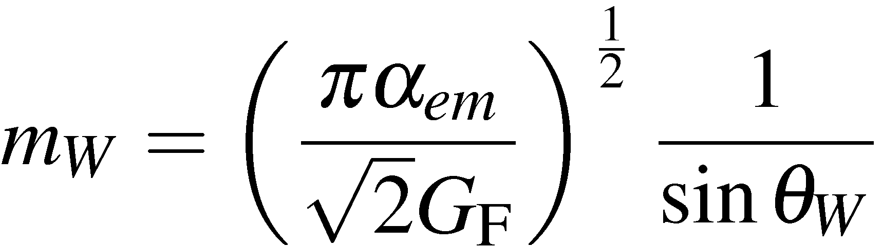
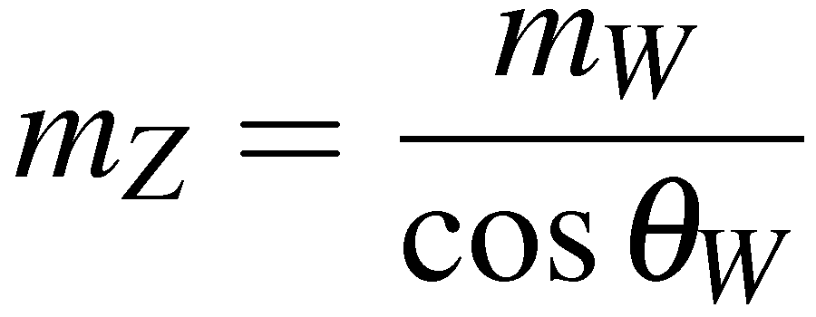
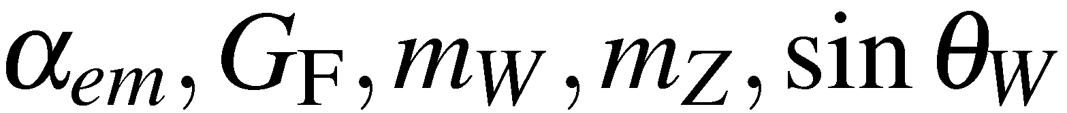
The Higgs mechanism results in absolute predictions for masses of gauge bosons
In the SM, fermion masses are also ascribed to interactions with the Higgs field
- however, here no prediction of the masses – just put in by hand
Feynman Vertex factors:
Within the SM of Electroweak unification with the Higgs mechanism:
Relations between standard model parameters
Hence, if you know any three of : predict the other two.

Slide 5
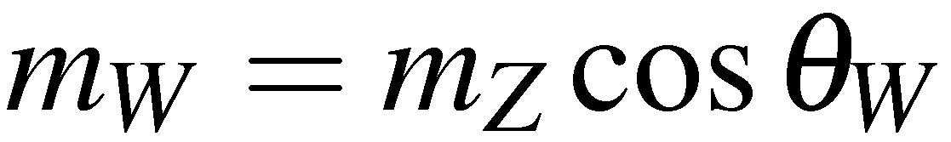

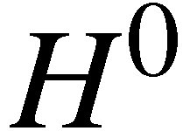



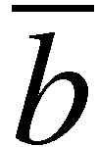
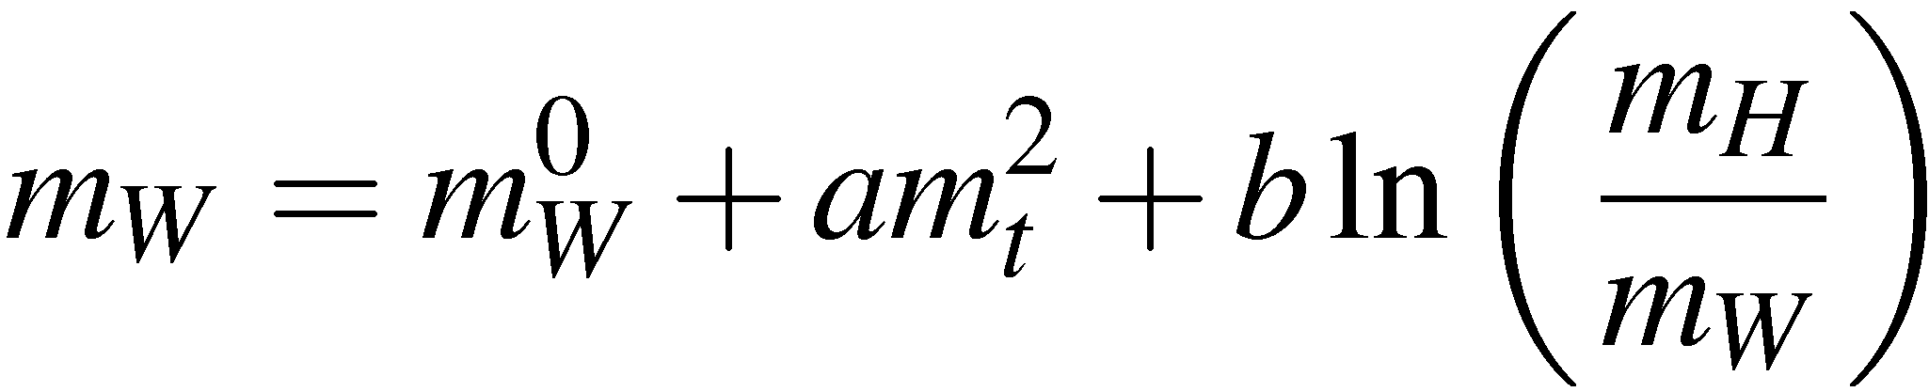
Precision tests of the Standard Model
From LEP and elsewhere have precise measurements – can test predictions
of the Standard Model !
e.g. predict:
measure
Therefore expect:
but
measure
Close, but not quite right – but have only considered lowest order diagrams
Mass of W boson also includes terms from virtual loops
Above “discrepancy” due to these virtual loops, i.e. by making very high precision
measurements become sensitive to the masses of particles inside the virtual loops !

Slide 6
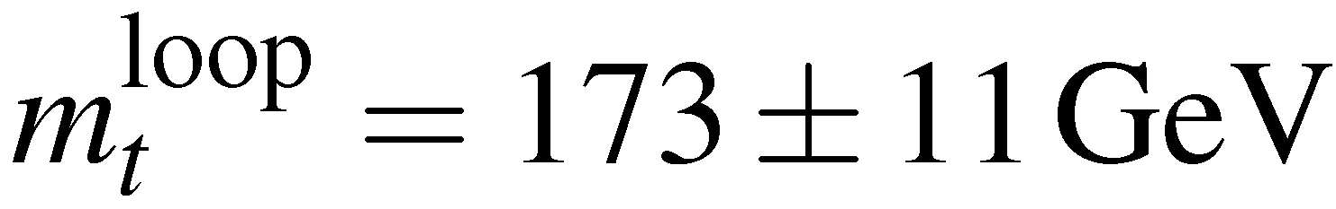

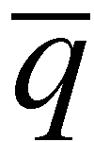
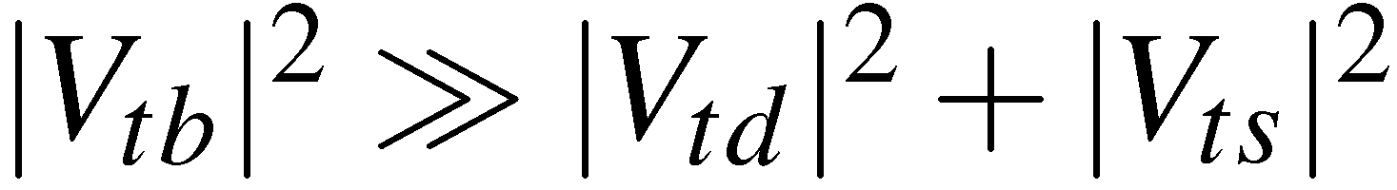
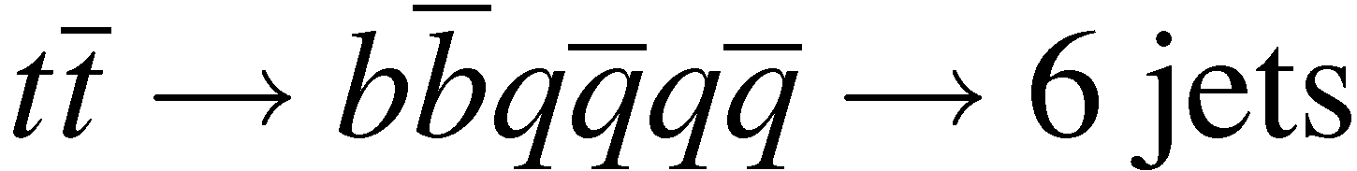
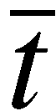

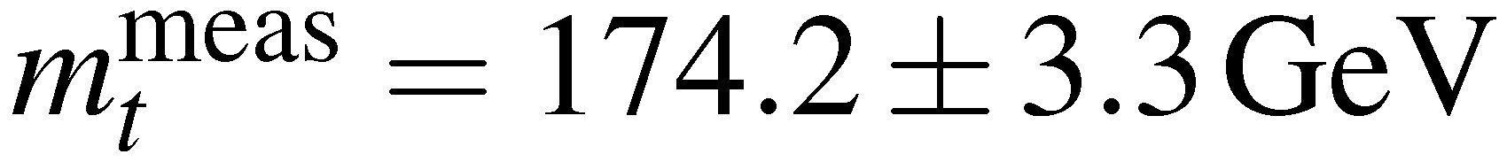
The top quark
From virtual loop corrections and precise LEP data can predict the top quark mass:
In 1994 top quark observed at the Tevatron proton anti-proton collider at Fermilab
– with the predicted mass !
The top quark almost exclusively
decays to a bottom quark since
Complicated final state topologies:
Mass determined by direct reconstruction (see W boson mass)

Slide 7
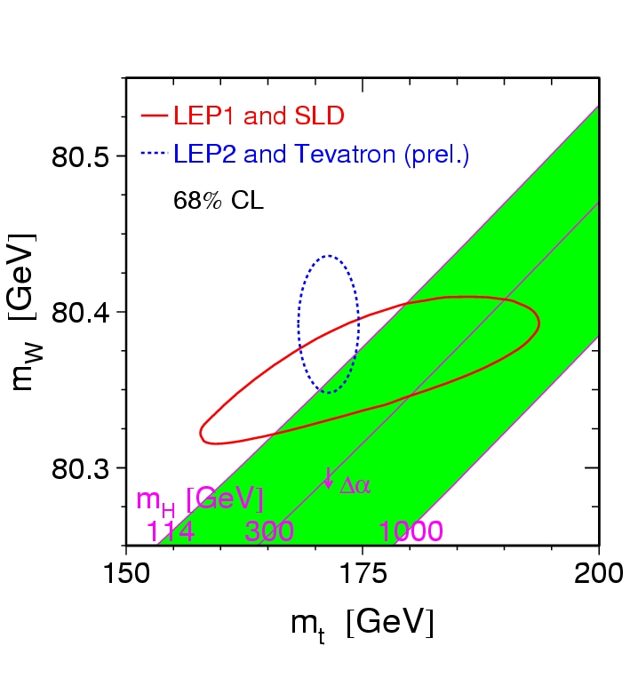
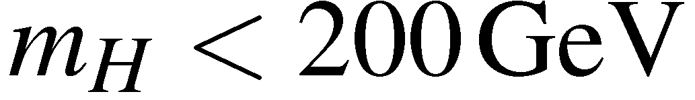
But the W mass also depends on the Higgs mass (albeit only logarithmically)
Measurements are sufficiently precise
to have some sensitivity to the Higgs
mass
Direct and indirect values of the top
and W mass can be compared to
prediction for different Higgs mass
Direct: W and top masses from
direct reconstruction
Indirect: from SM interpretation
of Z mass, θ_{W} etc. and
Data favour a light Higgs:

Slide 8
Before the top quark discovery
All met with Failure up to 1994

Slide 9
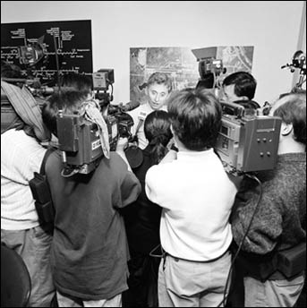
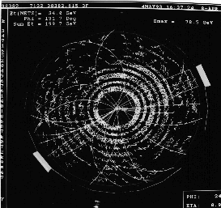
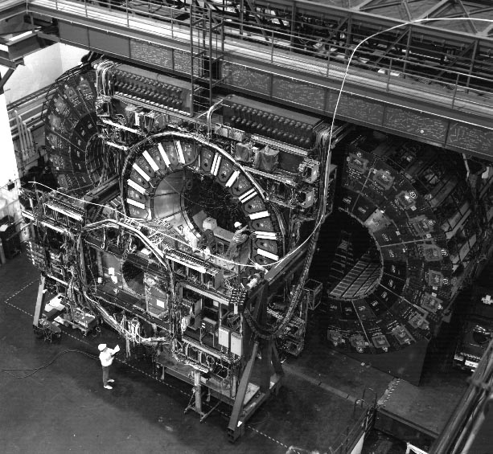
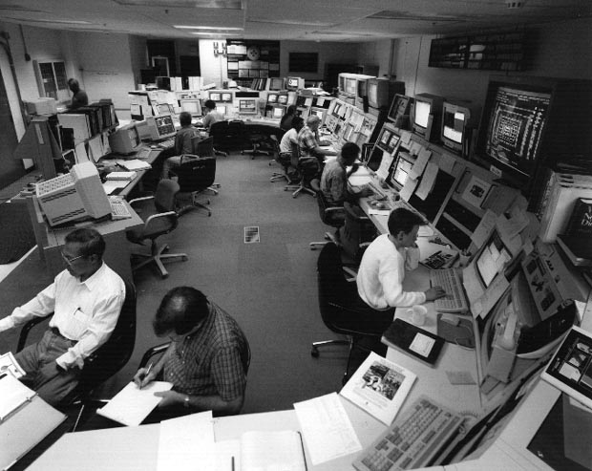
Top quark discovery
- Discovery of the top quark over a
decade ago at Fermilab was an extra-
ordinary scientific achievement and a
major confirmation of the standard model
- Back then, each experiment observed
only a handful of events (< 20).
- Today we have substantially more top
candidates than in 1995 (literally thou-
sands).
DØ Control Room
CDF Detector

Slide 10
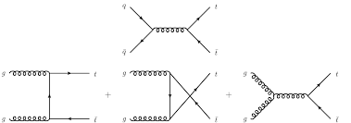
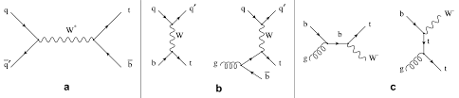
Top quark production
Via QCD
Via EWK

Slide 11
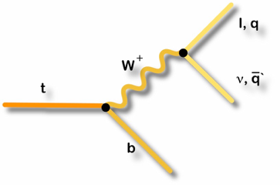
Top quark decay
Top decays via electroweak interactions
Due to large mass m_{t}>m_{W}+m_{b} and assuming unitarity:
^{BR(t⇒Wb) ~ 100%}
Top decays before hadronizing:
^{Γ~1.4 GeV >> Λ}_{QCD}

Slide 12
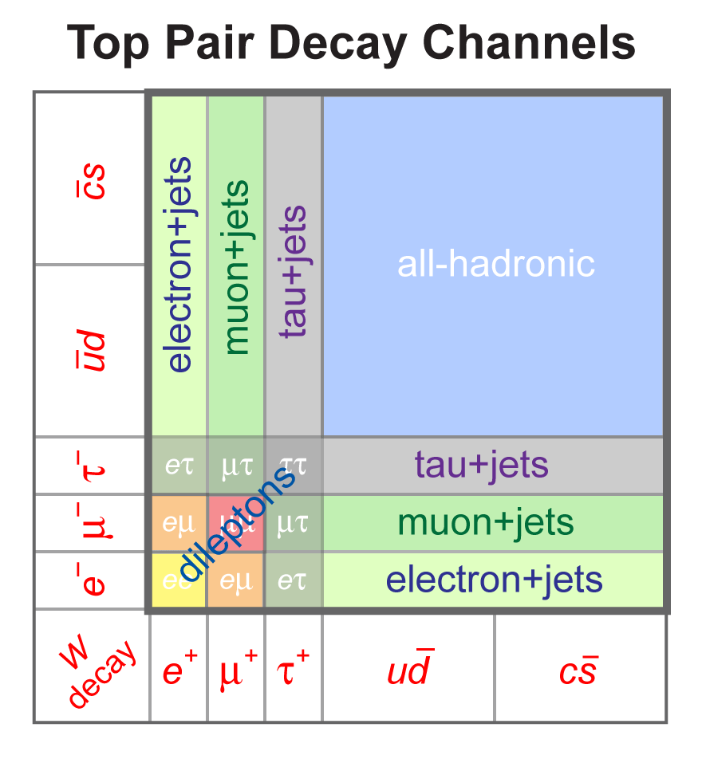
Top quark pair decay channels
tt decay signatures characterized by W decays:
All-Hadronic: 45% of all decays, large QCD background
Lepton+Jets: 30% of all decays, moderate backgrounds
Dilepton: 5% of all decays, very clean, but small branching fraction
Challenging signature: multiple leptons and (b-)jets, missing transverse energy

Slide 13
Top pair production (lepton+jets)
q
q
b
W⁺
b
W⁺
t
p
p
t
b
W⁻
l

Slide 14
Top pair production (lepton+jets)
Jet 2
Jet 1
Jet 3
q
q
W⁺
b
Primary interaction vertex
t
p
?
p
t
b
W⁻
l
Missing E_{T}
Jet 4
lepton

Slide 15
Ambiguity: processes
Jet 2
Jet 1
Jet 3
q
q
W⁺
b
Top pair
production ?
t
QCD multijet
production ?
W + jets
production ?
t
W⁻
b
W⁻
ν
ν
l
Missing E_{T}
l
Jet 4
lepton

Slide 16
Ambiguity: permutations
Jet 2
Jet 1
# | J1 | J2 | J3 | J4
Jet 3
# | J1 | J2 | J3 | J4
13 | b₁ | q₁ | q₂ | b₂
14 | b₁ | q₁ | b₂ | q₂
15 | b₁ | q₂ | q₁ | b₂
16 | b₁ | q₂ | b₂ | q₁
17 | b₁ | b₂ | q₁ | q₂
18 | b₁ | b₂ | q₂ | q₁
1 | q₁ | q₂ | b₁ | b₂
2 | q₁ | q₂ | b₂ | b₁
b₂
b₁
q₂
q₂
b₁
b₂
q₁
q₁
q₁
q₁
q₁
3 | q₁ | b₁ | q₂ | b₂
q₁
q₂
b₂
b₁
b₂
q₂
4 | q₁ | b₁ | b₂ | q₂
b₁
5 | q₁ | b₂ | q₂ | b₁
6 | q₁ | b₂ | b₁ | q₂
7 | q₂ | q₁ | b₁ | b₂
8 | q₂ | q₁ | b₂ | b₁
9 | q₂ | b₁ | q₁ | b₂
10 | q₂ | b₁ | b₂ | q₁
11 | q₂ | b₂ | q₁ | b₁
12 | q₂ | b₂ | b₁ | q₁
19 | b₂ | q₁ | q₂ | b₁
20 | b₂ | q₁ | b₁ | q₂
21 | b₂ | q₂ | q₁ | b₁
22 | b₂ | q₂ | b₁ | q₁
23 | b₂ | b₁ | q₁ | q₂
24 | b₂ | b₁ | q₂ | q₁
Total of 24
permutations !
b₁
q₂
b₂
b₁
b₂
q₂
Missing E_{T}
Jet 4
lepton

Slide 17
2jet and 3jet mass distributions
If you looked only at top events (no background), selected only those in which jets are matched to partons, and plotted the 2-jet and 3-jet invariant mass distributions using the correct jet permutation (assuming you know their identities), this is what you would get:
W
top

Slide 18
2jet and 3jet mass distributions
But of course, you don’t know the correct permutation, so you would calculate the invariant mass for all possibilities and end up with the following distributions:
W
top
So even if you can eliminate background events completely, making a precise measurement of the top quark properties is still very challenging.

Slide 19
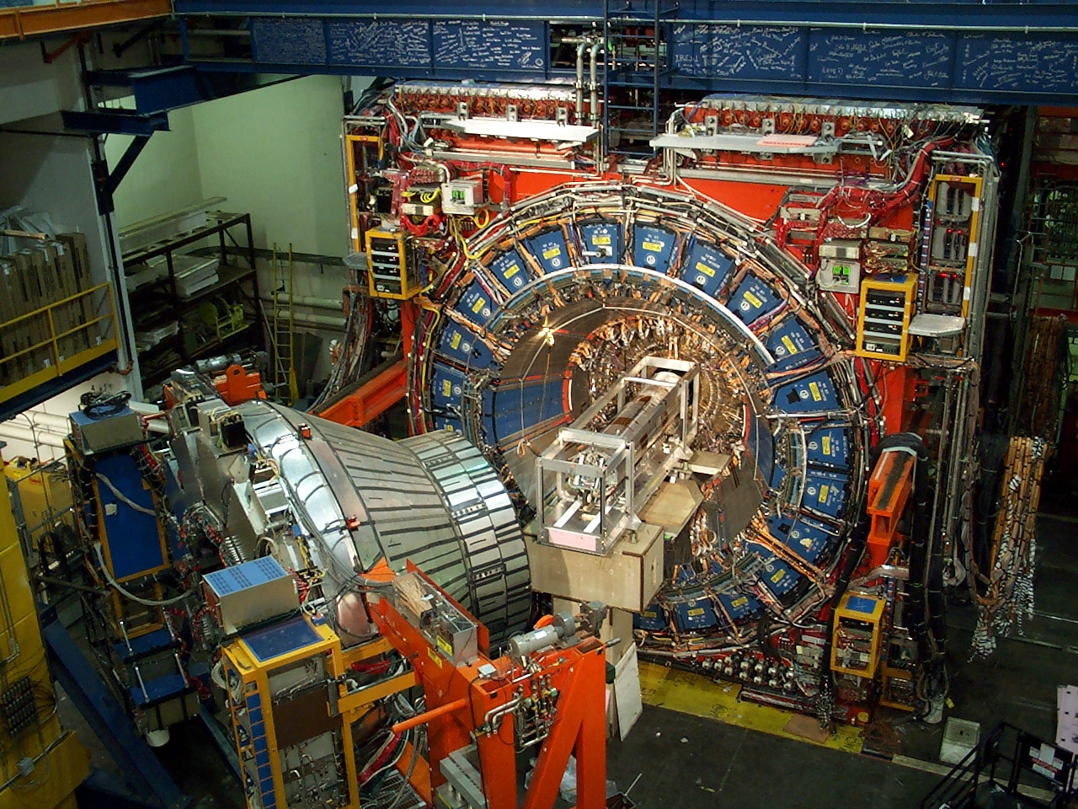
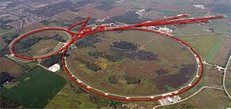

CDF and D0 detectors
Tevatron proton-antiproton collisions
Run I: operating 1992-1996 at 1.8 TeV
Run II: operating 2001-2011 at 1.96 TeV

Slide 20
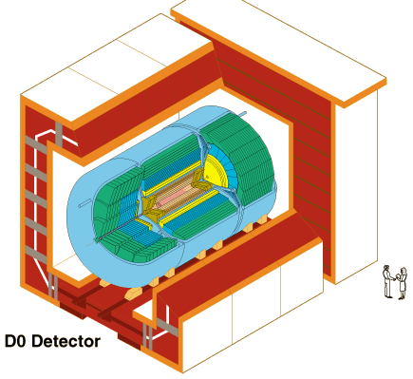
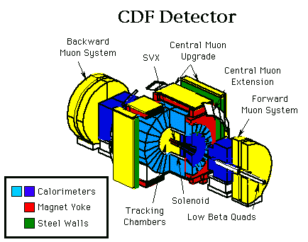
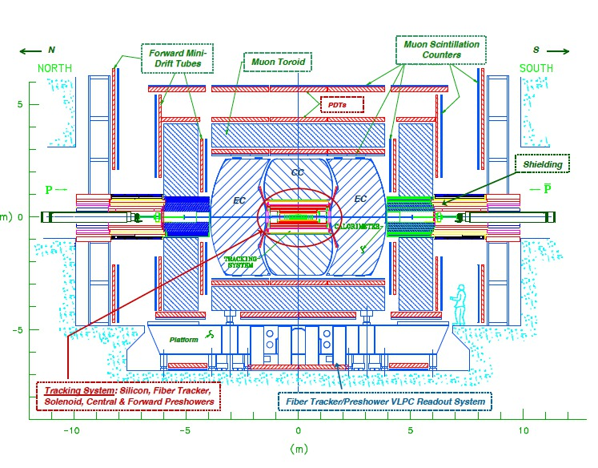
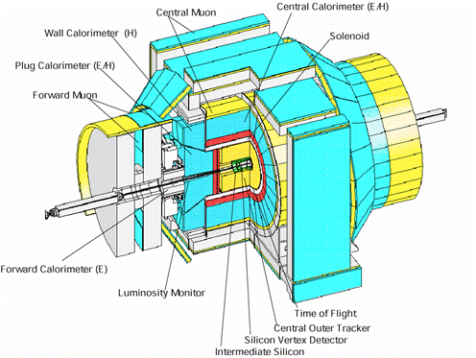
CDF and D0 detectors
Silicon detectors
Drift chamber (CDF), fiber tracker (D0)
Electromagnetic and hadronic calorimeters
Muon system

Slide 21
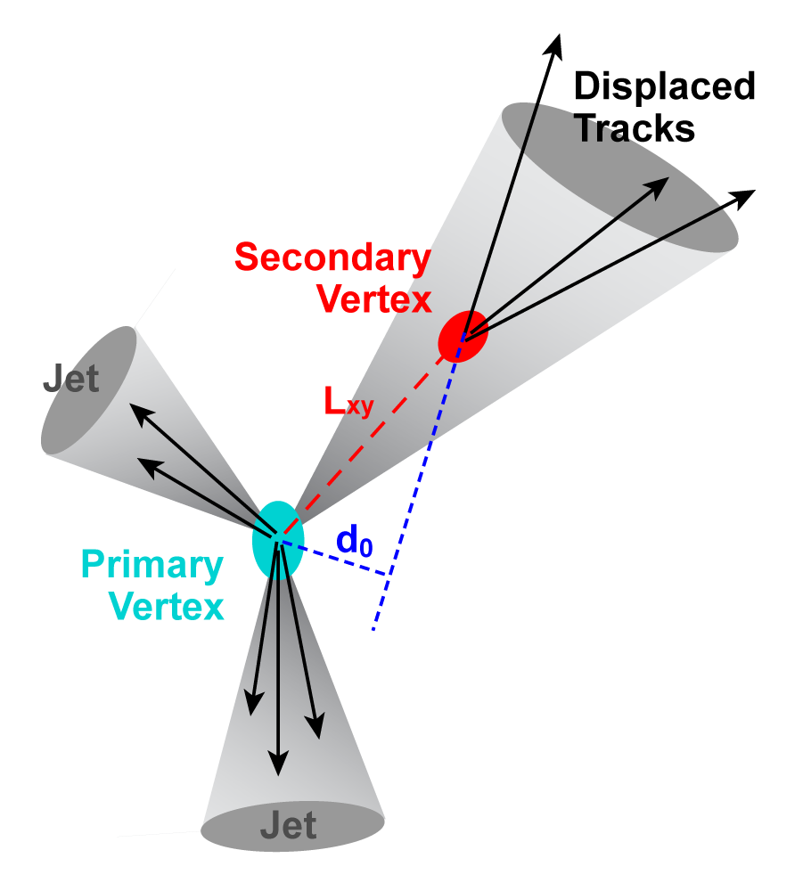
B-tagging
Interesting particles decay into final states with b quarks
E.g. H → bb, t → Wb
Need powerful “b-tagging”
Approach I: B hadrons are massive and “long-lived” (cτ of B± = 491 μm)
Tracks with large impact parameter
Displaced secondary vertex with large “vertex mass” (invariant mass of all charged particles in vertex)
Approach II: Semileptonic decays B → lνX: jets with soft leptons

Slide 22
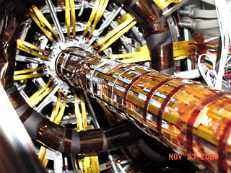
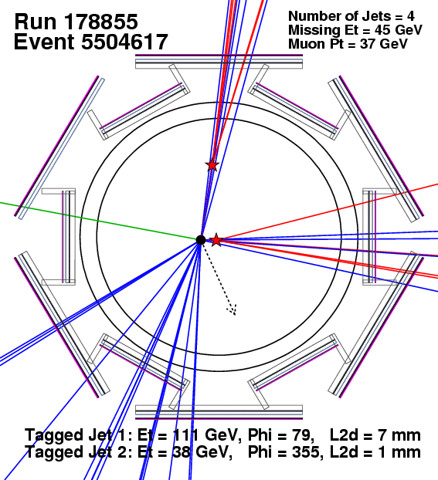
B-tagging
Example: “double-tag” event at CDF
Lepton (here: μ)
Neutrino (MET)
Quarks (4 jets, 2 b-tagged)
Key detector component: vertex detector
Tevatron: silicon strip detector
LHC: silicon pixel detector

Slide 23

Top quark mass
Top is most massive of
all quarks and leptons
Large coupling to the
Higgs boson
~35x
Special role in EW
symmetry breaking
~20x

Slide 24
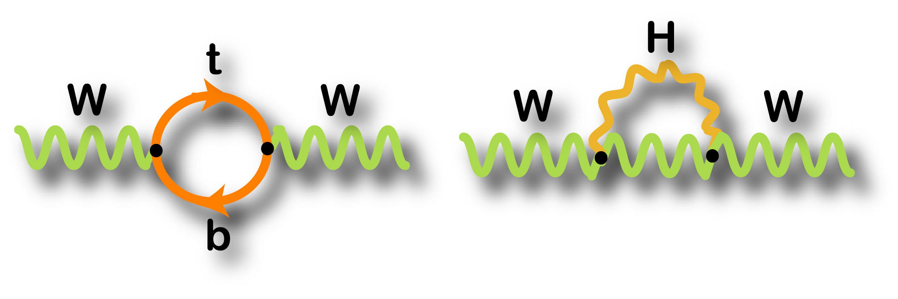
Top quark mass
Consider the mass of the W boson:
(1+Δr)
Radiative corrections
m_{t} enters quadratically while m_{h} enters logarithmically, so a precise knowledge of the W and top quark masses will constrain the Higgs mass
Mass near the electroweak symmetry breaking scale, has “natural” Yukawa coupling: λ_{t}= sqrt(2) m_{top}/v ~1

Slide 25
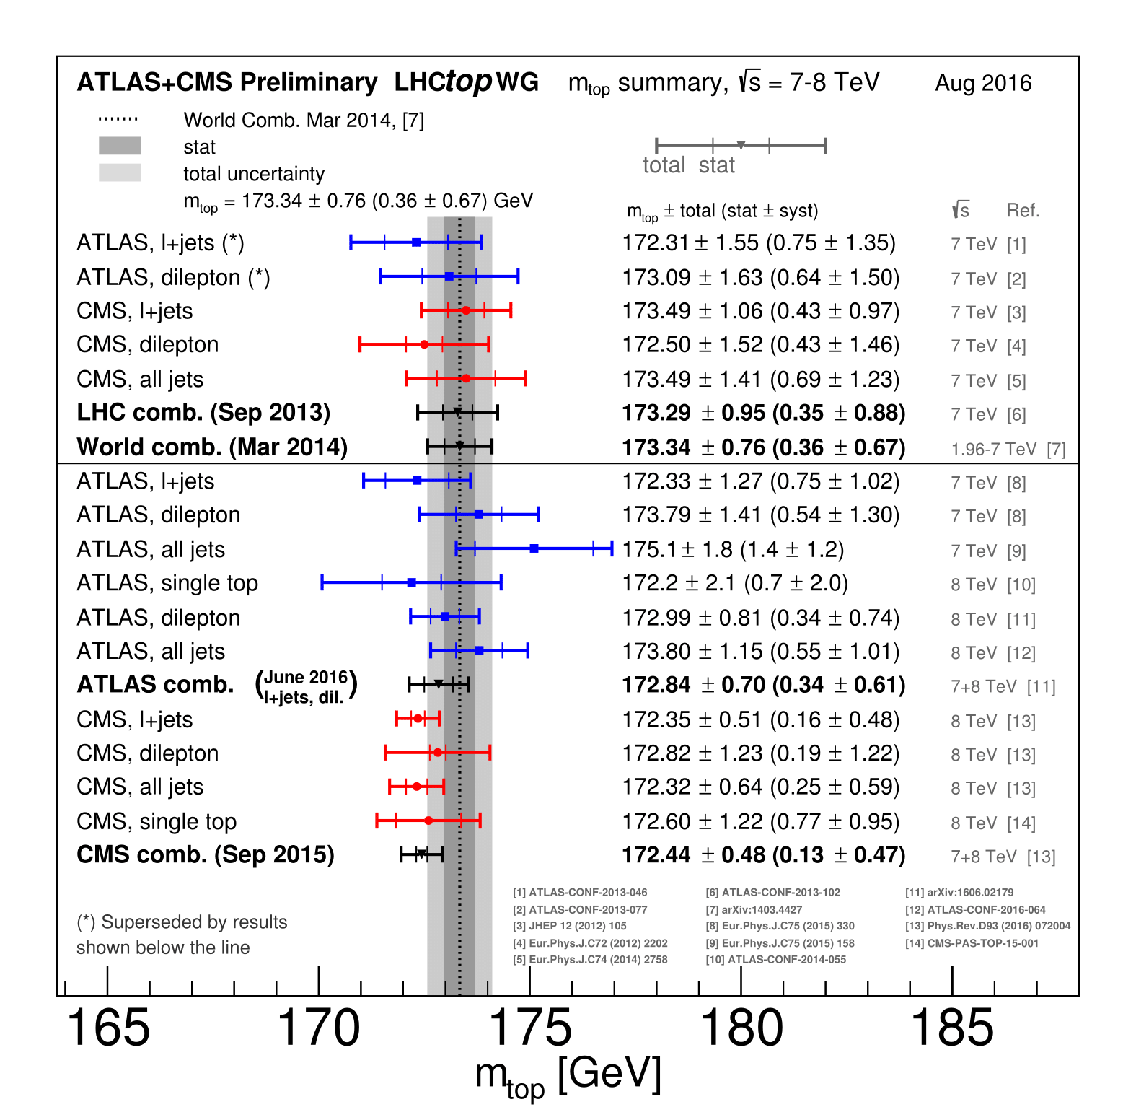
Top quark mass

Slide 26
Which top mass ?
Long-standing discussion between experimentalists and theorists: which top mass is measured?
Theory: different mass definitions available
Pole mass: pole of propagator → top is colored object: not well defined
Running mass (well defined in a given renormalization scheme, e.g. MSbar in lowest order):
Experimental methods: use mass parameter in MC generator → “almost” pole mass (e.g. Pythia = NLO generator)

Slide 27
Vertex structure
b
b
W
Longitudinal
t
t
OR
t
W
W
b
Left
handed
V-A structure of t→bW decay
SM prediction:
f₀ = 0.697 (depends on m_{top})
f₊ ~ O(10⁻⁴)
Determine helicity fractions from angular distributions:
Search for deviations from SM
by measuring helicity fractions.
W rest frame
( θ* with respect to top direction or
to W direction in top rest frame )

Slide 28
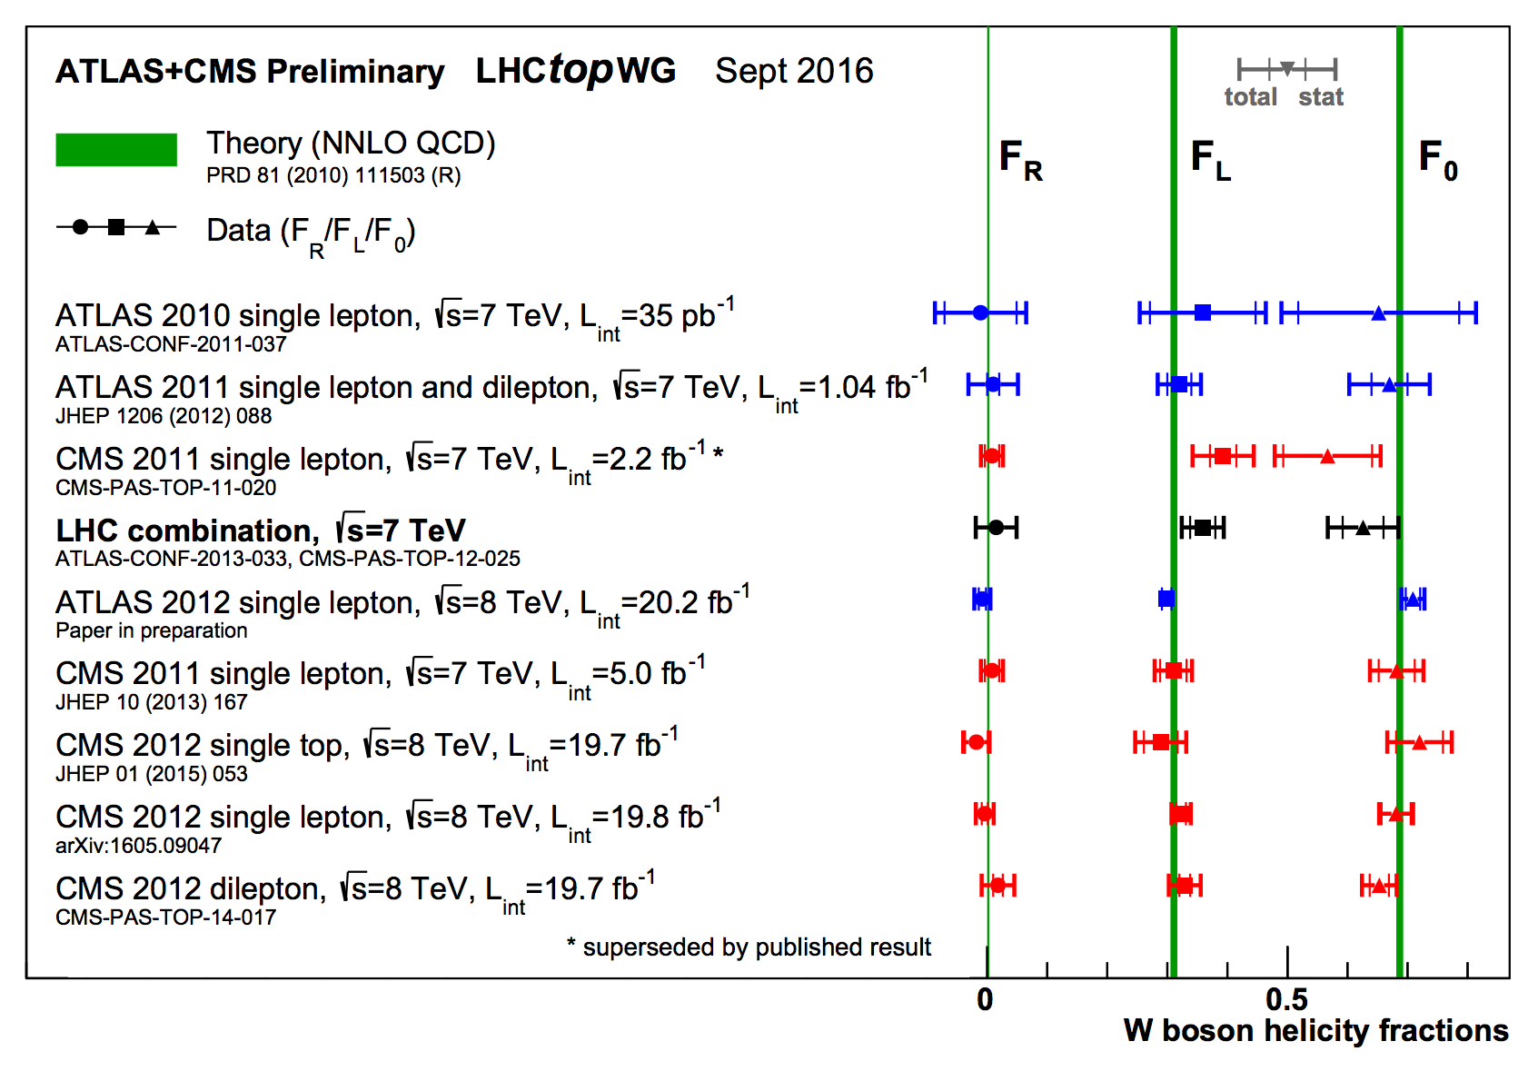
Vertex structure

Slide 29


Single top quark production
In 1985, ten years before the Top
quark discovery, the idea of single top
quark production was born.
Symmetry magazine Jan./Feb. 2007

Slide 30




Single top discovery
Discovered
March 1995!
σ_{NLO} = 6.7±0.8pb (m_{t}=175GeV/c²)
14 years!
Discovered
March 2009!
~|V_{tb}|
~|V_{tb}|
s-channel
σ_{NLO} = 0.88±0.07pb
t-channel
σ_{NLO} = 1.98±0.21pb
(m_{t}=175 GeV/c²)
B.W. Harris et al., Phys. Rev. D66, 054024
Z. Sullivan, Phys. Rev. D70, 114012 (2004).
Compatible Results;
Campbell/Ellis/Tramontano, Phys. Rev. D70, 094012 (2004).
N. Kidonakis, Phys. Rev. D74, 114012 (2006).

Slide 31


Why single top is important ?
Access to the W-t-b vertex
V-A structure
access to top quark spin
Allows measurement of CKM matrix element |V_{tb}|:
Is this Matrix 3x3 ? Is there a 4th generation ?
Does unitarity hold ?
“simple” 4th generation ruled out by EW fits but see e.g.
|V_{tb}|
Direct measurements
Ratio from Bs oscillations
Not precisely measured
Inferred using unitarity
J. Alwall et. al., “Is |V_{tb}|~1?” Eur. Phys. J. C49 791-801 (2007).

Slide 32




Single top quark results
There are many results form LHC experiments currently on single top

Slide 33



Vtb direct measurement
Using cross section result measure |V_{tb}|
Don’t assume 3 gen or unitarity of CKM matrix
Assume Standard Model (V-A) coupling
And |V_{tb}| >> |V_{ts}|, |V_{td}|
(from BR(t →Wb) measurements)‏
|V_{tb}|>0.71 at 95% C.L.
|V_{tb}|>0.78 at 95% C.L.
|V_{tb}|= 0.91 ± 0.11 (stat+syst) ± 0.07 (theory)‏
|V_{tb}|= 1.07 ± 0.12 (stat+syst)

Slide 34

CDF significance
Analysis | Significance Std.Dev. (σ) | Sensitivity Std.Dev. (σ)
NN | 3.5 | 5.2
ME | 4.3 | 4.9
LF | 2.4 | 4.0
LFS | 2.0 | 1.1
BDT | 3.5 | 5.2
SD | 4.8 | >5.9
MJ | 2.1 | 1.4
Combined | 5.0 | >5.9
3.1 x 10⁻⁷
Use many multivariate analysis technique
to extract the signal. Compare for consistency and combine for better precision
Expected p-value : xxx x10 ⁻¹⁰: >5.9σ
Observed p-value: 3.1 x10^{-7 :} 5.0σ
This requires 400 Mio pseudo-experiments!

Slide 35
Tuesday lectures
Date | Topic | Student
Sept 27 | Positron (p9) Muon (p29) Pion (p34) | Nici Alex Kevin
Oct 4 | Unstable particles (p65 or p71) Anti-p (p87) or Anti-n (p94) | Lukas Oliver
Oct 11 | Omega-(p144) Parity violation in beta (p163) Parity violation in pions (165) | Magnus Nici Alex
Oct 18 | K-long (p197) CP violation (p206) | Kevin Lukas
Oct 25 | Tau lepton J and Psi Charm meson | Oliver Magnus Nici
Nov 2 | Quarks SLAC Upsilon | Magnus Lukas
Date | Topic | Student
Nov 8 | Jets UA2 Gluons TASSO | Alex Kevin
Nov 15 | Neutral currents Discovery of the W boson | Nici Oliver
Nov 22 | Neutrino types Parity non-conserving | Magnus Lukas
Nov 29 | Discovery of the top quark Top quark mass measurement | Alex Kevin
Dec 6 | ARGUS CDF (or Belle/Babar)
Dec 13 | Solar Atmospheric
Dec 20 | Higgs discovery by ATLAS or CMS Measurements of Higgs boson properties
From pages from R. Cahn and G. Goldhaber book if available

